Slide 1

Analysis of Reviews
British Airways

Slide 2
Source: AirlineQuality.com
Parameters:
Date: Date when the review was written
Name: Name of the reviewer
Place: Place of the reviewer
Aircraft: type of the aircraft (A350-1000/ Boeing 777, etc)
Type of traveller: Family, couple, solo leisure or business
Route: The route of the airtravel
Date flown
Star Ratings for(out of 5) :
Seat comfort
Cabin staff service
Food and beverages
Inflight Entertainment
Ground Service
Value for Money
Recommended: If reviewer would recommend BA (yes/no)
Rating Value: Overall rating over 10
Review title
Verification: If the reviewer is verified
Review Content: A detailed review given
https://www.airlinequality.com/airline-reviews/british-airways

Slide 3
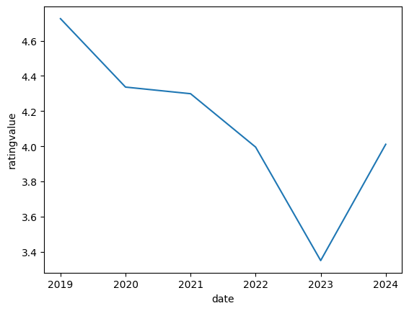
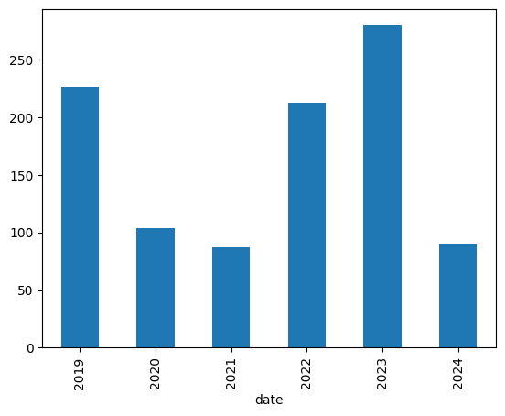
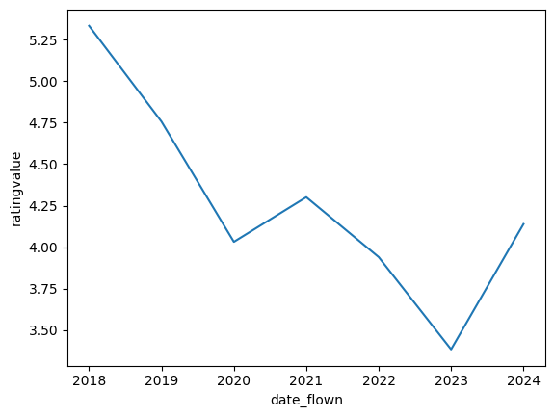
Reviews over time
Average of the reviews over time
(date of review posted)
Number of Reviews over time
The year 2023 had, the highest number of reviews but the reviews were abysmal.
The overall trend of the reviews is negative.
Average of the reviews over time
(date flown)

Slide 4
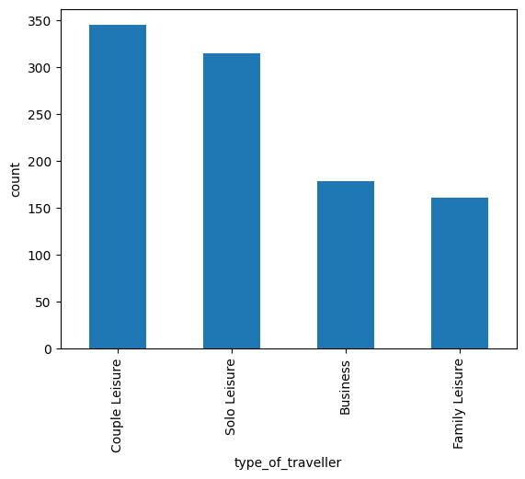
Type of Traveler and ratings

Slide 5
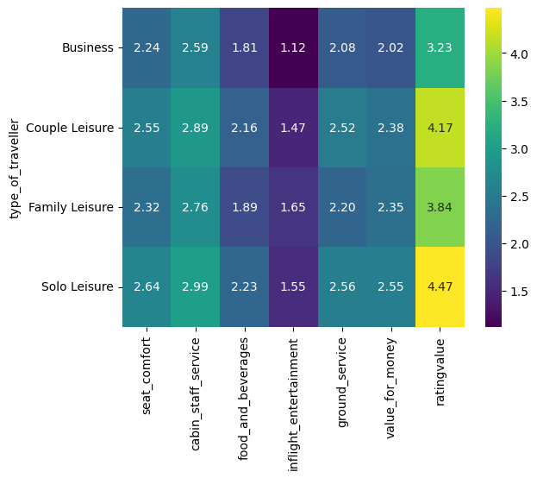
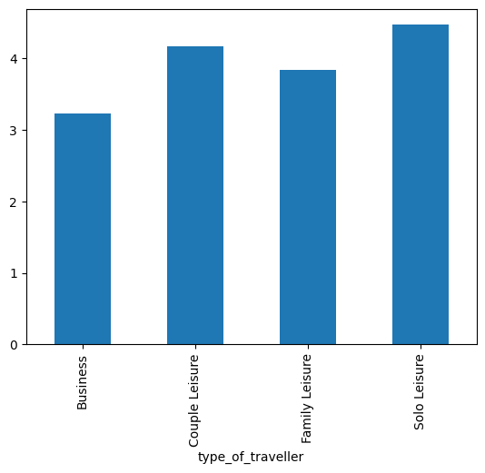
Type of Traveler and ratings
Relationship of Type of traveler with the average star ratings
Solo leisure travelers seem to be the most satisfied
Business travelers have the lowest average rating.

Slide 6
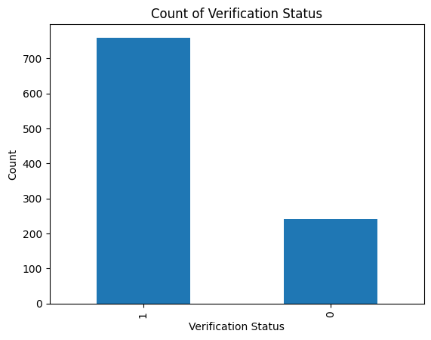
Verification and Rating Value

Slide 7
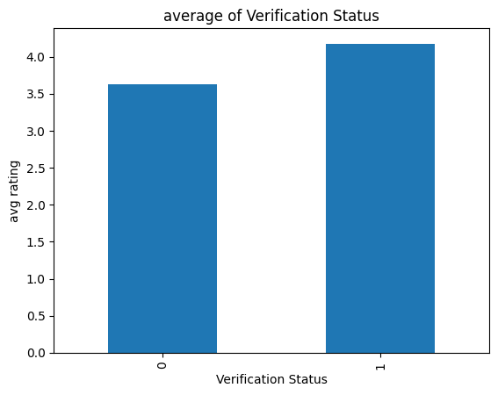
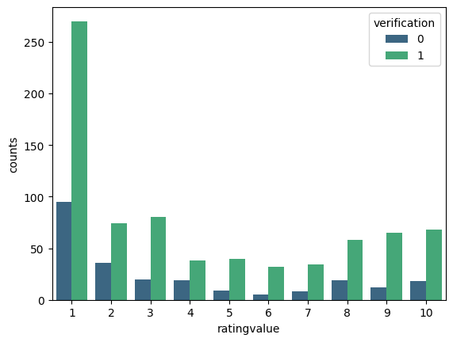
Verification and Rating Value
The comments which can be trusted have given a higher rating
Many of the verified users have given the rating 1

Slide 8
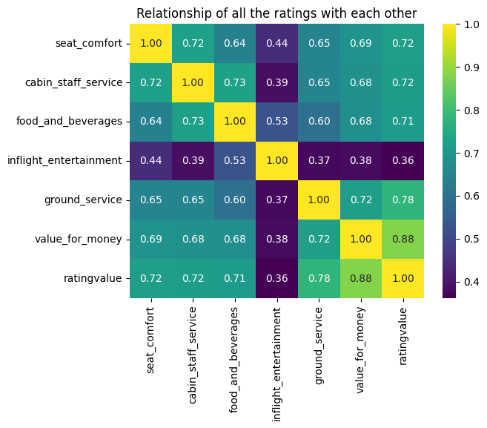
Relationship of all ratings with eachother

Slide 9
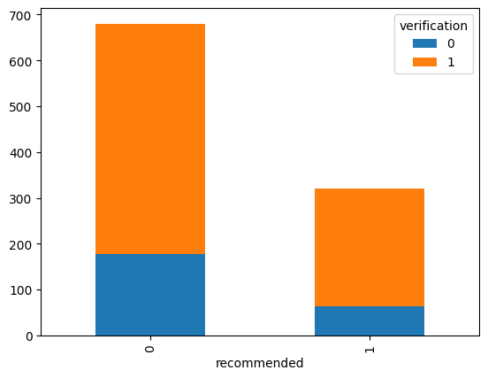
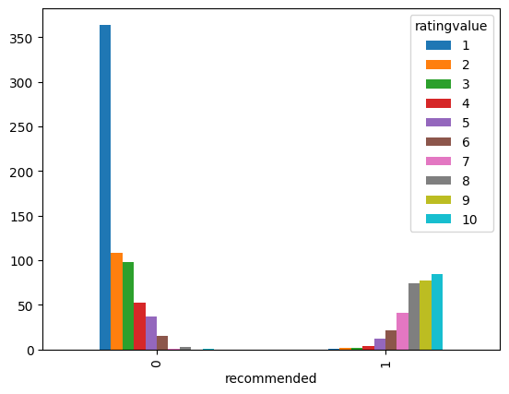
Recommendations
Most of the verified users would not recommend BA

Slide 10
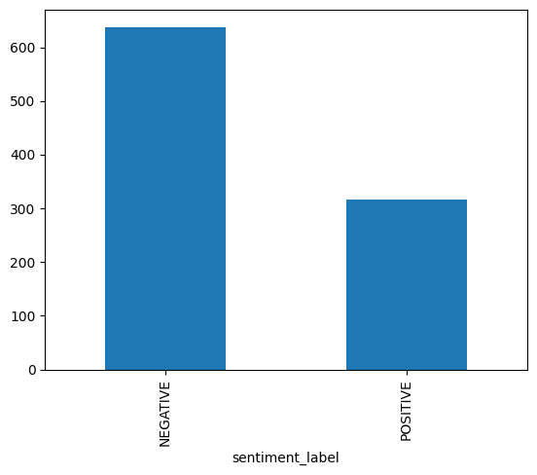
Sentiment Analysis on Reviews
Most reviews have a negative sentiment

